Slide 1
Nguyen Binh Khiem secondary school
Welcome to our English Group!
Subject: Cuisine
Wednesday, March 13th, 2024

Slide 2
CONTENTS
ACTIVITY 1
INTRODUCTION OF TEAMS
ACTIVITY 2
CHECKING KNOWLEDGE
ACTIVITY 3
COOKING EXPERIENCE

Slide 3
ACTIVITY 1:
INTRODUCTION OF TEAMS

Slide 4
ACTIVITY 2
CHECKING KNOWLEDGE

Slide 5
Question 1:
0
1
2
3
4
5
6
7
8
9
10
1. What dish is it ?
--> Red noodle
soup

Slide 6
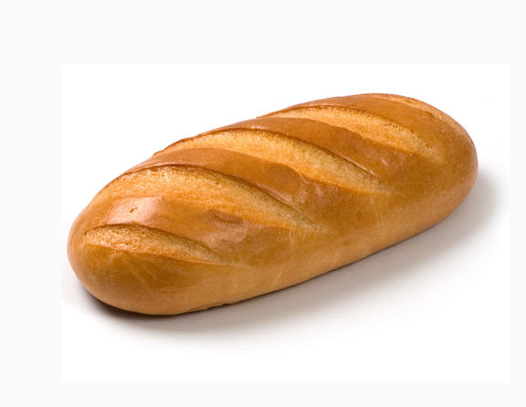
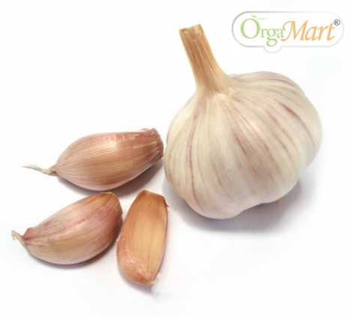
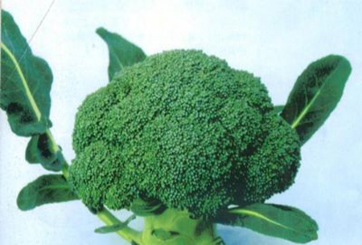
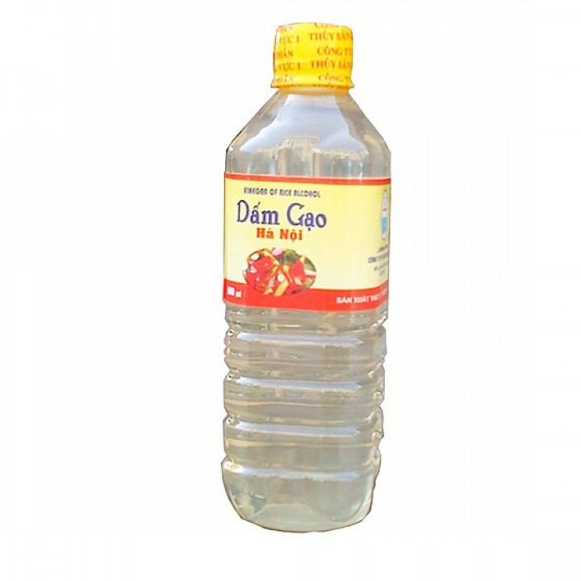
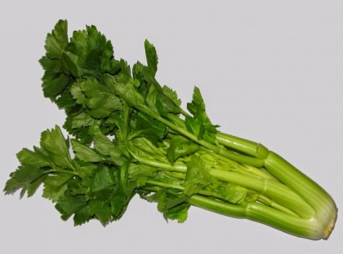
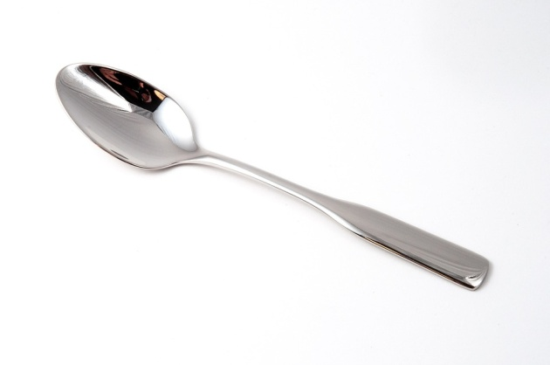
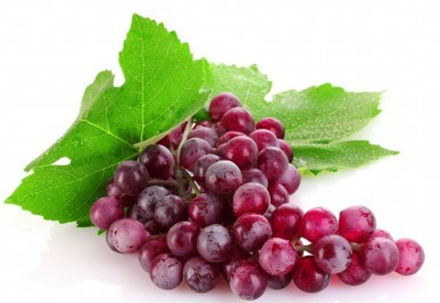
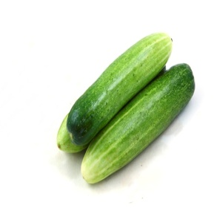
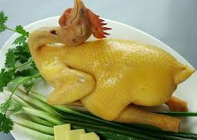
Question 2: What are these food.
0
1
2
3
4
5
6
7
8
9
10
Bread
cabbage
Bananas
Garlic
Celery
Spoon
Rice oil
Cucumbers
Chicken
Grapes

Slide 7
Question 3. How can we make this dish?
Boil
B. Grill
C. Stew
D. steam
o
0
1
2
3
4
5
6
7
8
9
10

Slide 8
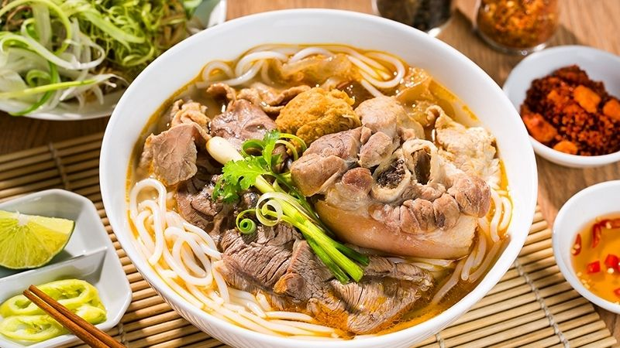
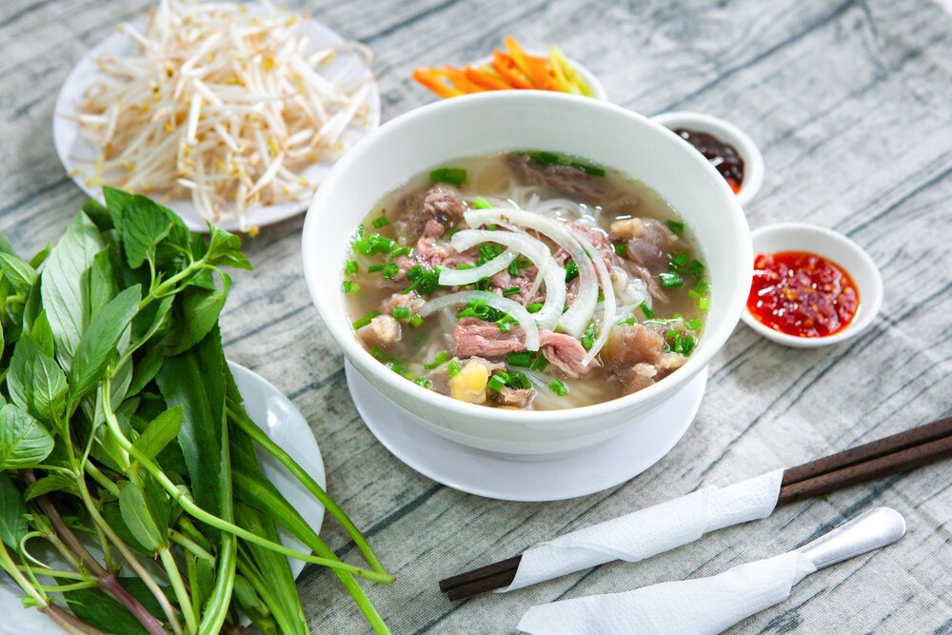
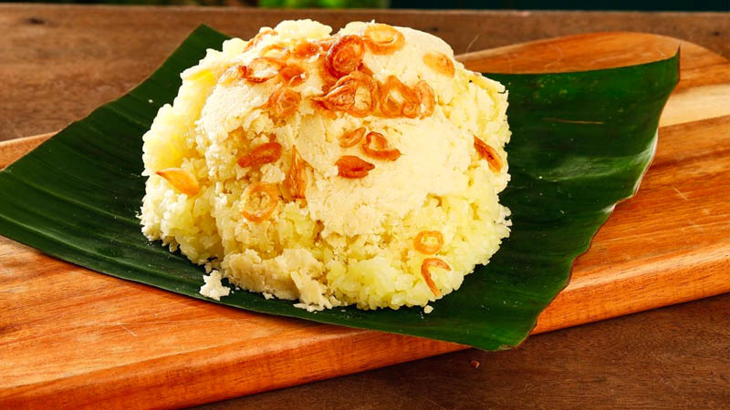
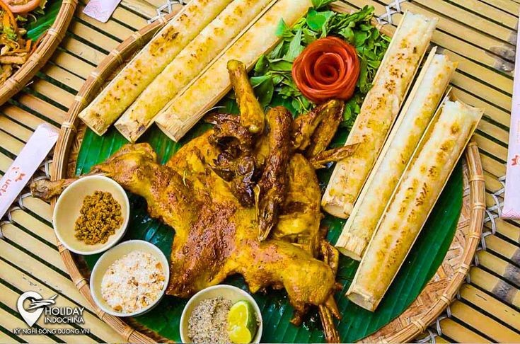
0
1
2
3
4
5
6
7
8
9
10
Question 4. What do you think is the specialty dish in Dak Lak ?
Phở bò
Xôi
CơmLam
D. Bún bò
o

Slide 9
Question 5:
0
1
2
3
4
5
6
7
8
9
10
What dish is it?
It is a Vietnamese-style sandwich with a crusty bread roll filled with a variety of ingredients such as grilled pork, pate, pickled vegetables, and fresh herbs. It is a popular street food in Vietnam.
Bánh mì

Slide 10
Question 6:
0
1
2
3
4
5
6
7
8
9
10
Could you tell the name of the dish basing on the picture?
Sushi
Sushi (món cơm cuộn của Nhật Bản) = Shoe (chiếc giày) + She (cô gái)

Slide 11
Question 7:
0
1
2
3
4
5
6
7
8
9
10
What kind of room has no doors or windows ? It is an ingredient.
Mushrooms

Slide 12
Question 8:
0
1
2
3
4
5
6
7
8
9
10
What dish is the most famous in Ho Chi Minh City?
A. Phở bò
B. Cao lầu
C. Bún bò
D. Hủ tiếu

Slide 13
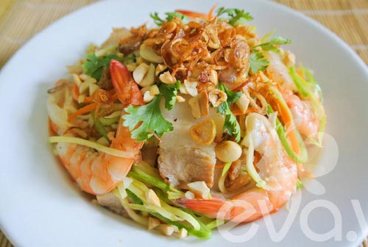
Question 9:
0
1
2
3
4
5
6
7
8
9
10
What dish is it?
Prawn/Shrimp Salad

Slide 14
Question10:
0
1
2
3
4
5
6
7
8
9
10
Complete the sentence below:
She needs a________ garlic for this dish.
A: bunch of.
B: stick of
C: bottle of
D: clove of

Slide 15
Question 11:
0
1
2
3
4
5
6
7
8
9
10
How many components are there in a typical Japanese meal?
A: There are four (rice, miso soup, main dish(es), pickles).
B: There are two ( miso soup, main dish(es) ).
C: There is one (rice).
D: There are three (rice, miso soup, main dish(es)).

Slide 16
Question 12:
0
1
2
3
4
5
6
7
8
9
10
Which country is famous for curry?
A: Viet nam
B: America
C: India
D: Korea

Slide 17
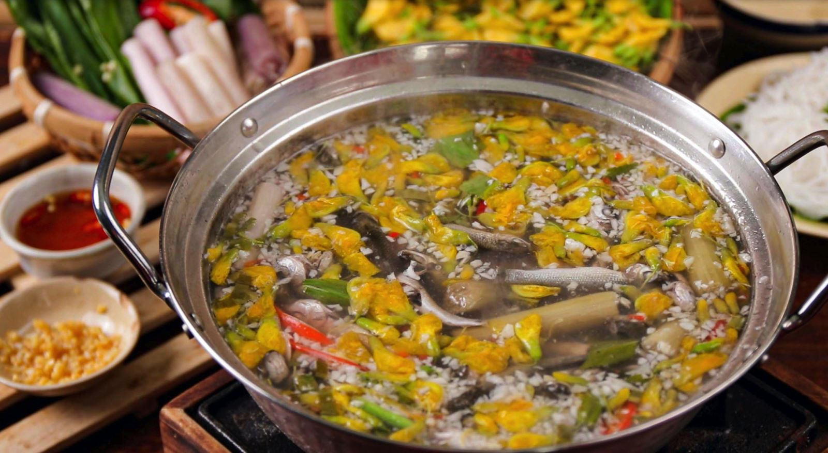
Question 13 :
0
1
2
3
4
5
6
7
8
9
10
Which region of Viet Nam does this dish belong to ?
In the southern area.

Slide 18
Question 14: What food is it?
0
1
2
3
4
5
6
7
8
9
10
It is a square cake. It is represented the land. It is a traditional food at Tết. It is wrapped by dong or banana leaves.
Key: BÁNH CHƯNG/ Chưng cake

Slide 19
Question 15: How many dishes are going to be made?
What are ingredients used for each dish?
0
1
2
3
4
5
6
7
8
9
10
Salad and pizza
Pizza: Mushrooms, onions, sausages, tomatoes, pepper, cheese.
Salad: lettuce, cucumbers, carrots, eggs

Slide 20
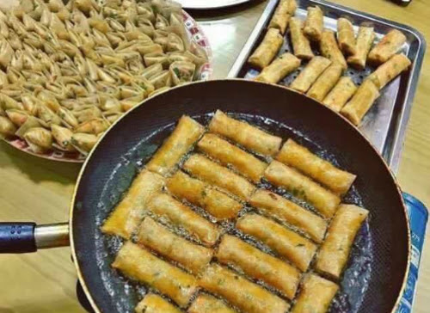
Question 16 How can people cook “spring rolls”?
0
1
2
3
4
5
6
7
8
9
10
A. stir- fried
B. deep –fried
C. steam
C. roast
Key: B. DEEP –FRIED

Slide 21
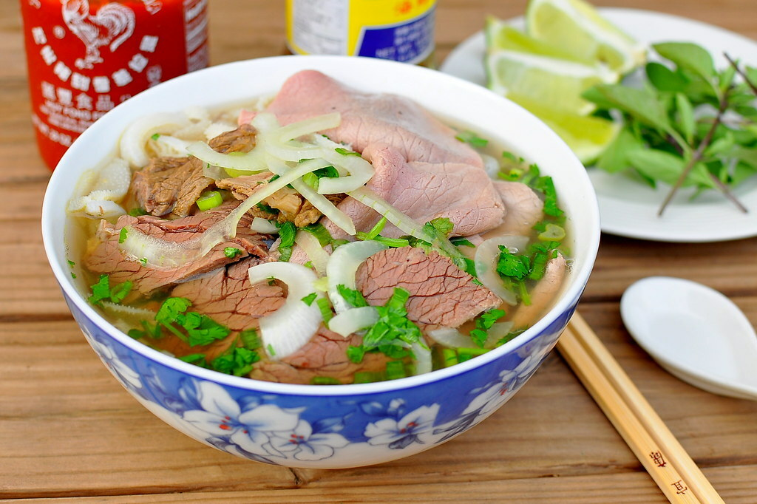
Question 17: What are the three main ingredients of Phở?
0
1
2
3
4
5
6
7
8
9
10
slice beef, broth and rice noodles

Slide 22
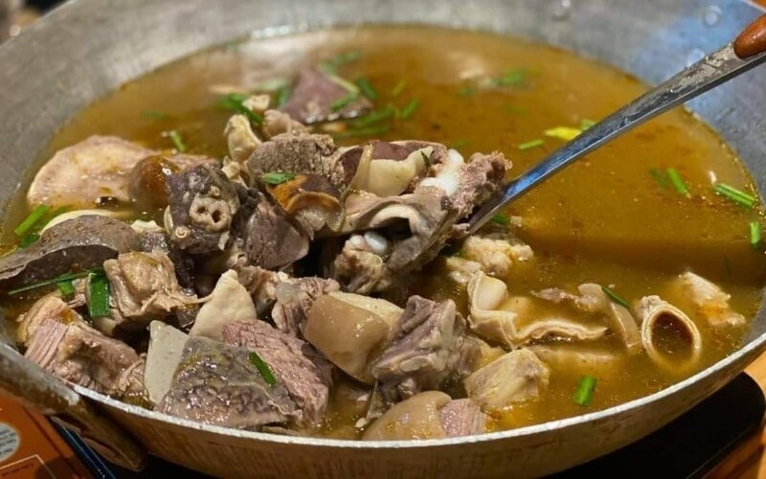
Question 18: Which ethnic group does the dish “Thắng cố” belong to?
0
1
2
3
4
5
6
7
8
9
10
The H’mông
The Êđê
The Tày
The Thái
A. The H’mông

Slide 23
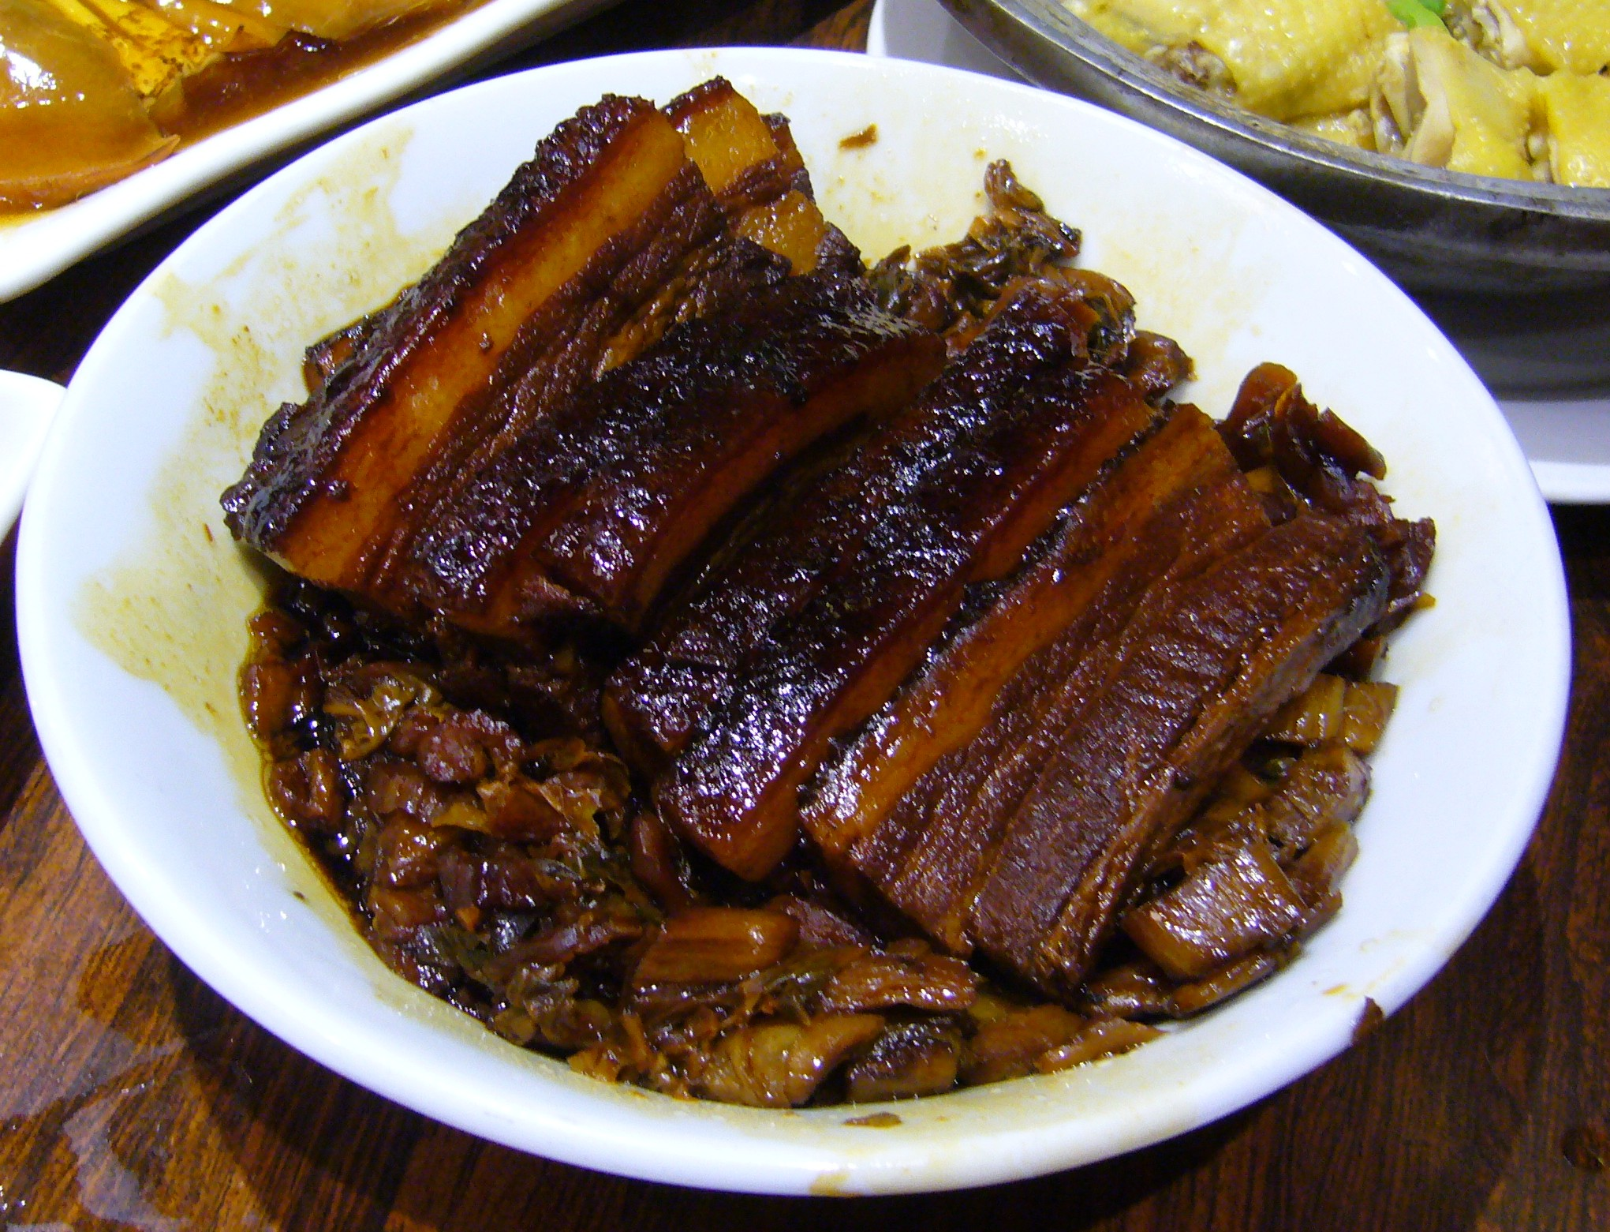
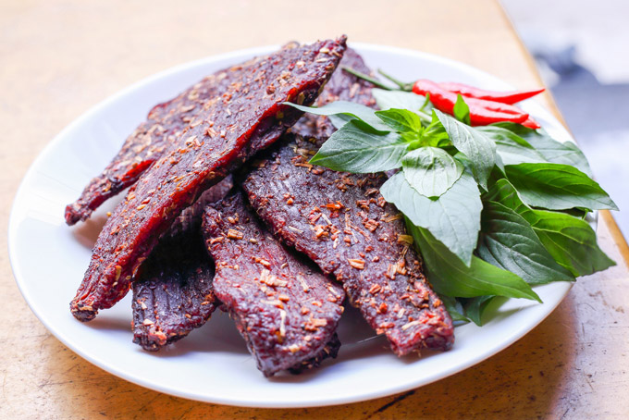
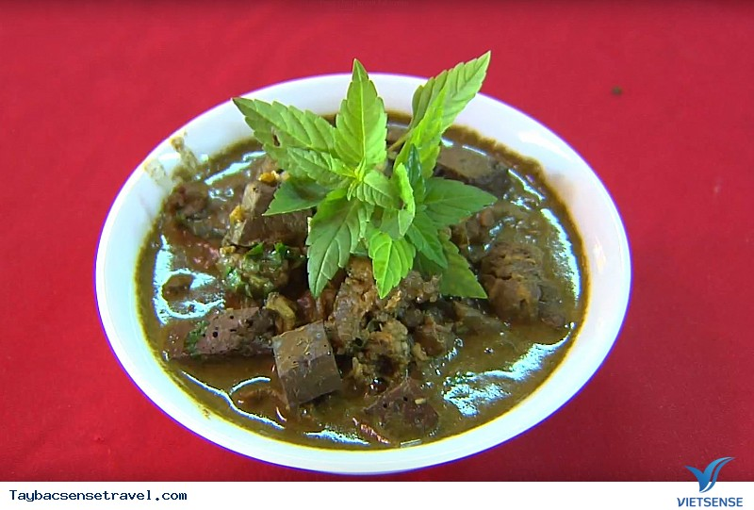
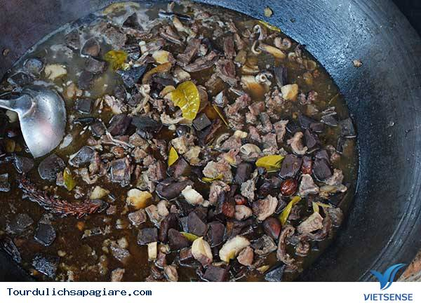
Question 19: Which dish is called “ Khâu Nhục”?
0
1
2
3
4
5
6
7
8
9
10
C.
A.
B.
D.

Slide 24
Question 20: Can you name five specialties of the Êdê?
Spicy and sour ripe papaya dish. Sour soup with golden architecture. Ve dish. Salt fried rice base. Stir-fried noodle leaves. Grilled bamboo shoots stir-fried with beef Heavy eggplant soup cooked with dried fish Central Highlands forest leaf hotpot.
Spicy and sour ripe papaya dish. Sour soup with golden architecture. Ve dish. Salt fried rice base. Stir-fried noodle leaves. Grilled bamboo shoots stir-fried with beef Heavy eggplant soup cooked with dried fish Central Highlands forest leaf hotpot.
0
1
2
3
4
5
6
7
8
9
10
Possible answers:
-Spicy and sour ripe papaya dish.
-Sour soup with golden architecture.
-Ve dish.
-Salt fried rice base.
-Stir-fried noodle leaves.
-Grilled bamboo shoots stir-fried with beef
-Heavy eggplant soup cooked with dried fish
-Central Highlands forest leaf hotpot.
Possible answers :
-Món đu đủ giã chua cay.
-Canh chua kiến vàng.
-Món vếch.
-Dế cơm rang muối.
-Lá mì xào.
-Măng nướng xào vếch bò
-Canh cà đắng nấu cá khô
-Lẩu lá rừng Tây Nguyên.

Slide 25
ACTIVITY 3
COOKING EXPERIENCE

